Slide 1


<Doan Viet Nam>
<12/2/2022>

Slide 2

Outline
Executive Summary
Introduction
Methodology
Results
Conclusion
Appendix

Slide 3
Executive Summary
Summary of methodologies
Summary of all results

Slide 4
Introduction
Project background and context
Problems you want to find answers

Slide 5

Section 1

Slide 6
Methodology
Executive Summary
Data collection methodology:
make a get request to the SpaceX API.
Perform data wrangling
Dealing with Missing Values
Perform exploratory data analysis (EDA) using visualization and SQL
Perform interactive visual analytics using Folium and Plotly Dash
Perform predictive analysis using classification models
How to build, tune, evaluate classification models

Slide 7
Data Collection
First, we need api url.
Response=Request.get(url)
Data=pd.json_normalize(response.json())

Slide 8
Data Collection – SpaceX API
Present your data collection with SpaceX REST calls using key phrases and flowcharts
https://github.com/namdoanviet/SpaceX.git
Define url
Response=Request.get(url)
Data=pd.json_normalize(response.json())

Slide 9
Data Collection - Scraping
https://github.com/namdoanviet/SpaceX.git
url=“…”
response = requests.get(static_url).text
html_tables=soup.find_all("table")
first_launch_table = html_tables[2]

Slide 10
Data Wrangling
Dealing with Missing Values
Replace np.nan value in the data by mean of that column
m=data_falcon9['PayloadMass'].mean()
data_falcon9['PayloadMass'].replace({np.nan:m})
https://github.com/namdoanviet/SpaceX.git

Slide 11
EDA with Data Visualization
Scatterplot, barplot to visualize the relationship of 2 variables
lineplot to visualize how variable change yearly
https://github.com/namdoanviet/SpaceX.git

Slide 12
EDA with SQL
Select
From
Where
Group by
Order by
https://github.com/namdoanviet/SpaceX.git

Slide 13
Build an Interactive Map with Folium
folium.Map, folium.Circle, folium.map.Marker, MarkerCluster,
https://github.com/namdoanviet/SpaceX.git

Slide 14
Build a Dashboard with Plotly Dash
Pie chart, scatter plot and drop down menu
https://github.com/namdoanviet/SpaceX.git

Slide 15
Predictive Analysis (Classification)
Transform data
Split data into train and test data.
Create gridsearchcv for every model and fit them
Print the score of every model
Plot confusion matrix
https://github.com/namdoanviet/SpaceX.git

Slide 16
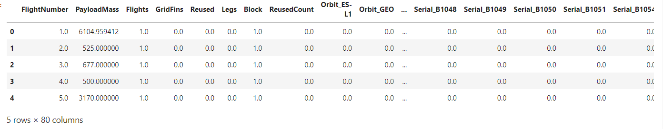
Results
The best model is decision tree

Slide 17

Section 2

Slide 18
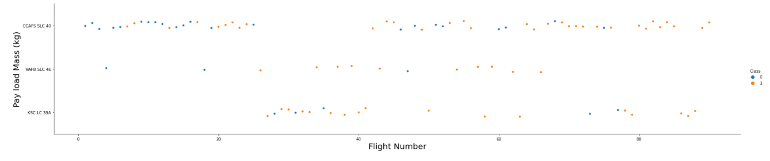
Flight Number vs. Launch Site
The more flight numbers is, the more successful first stage land

Slide 19
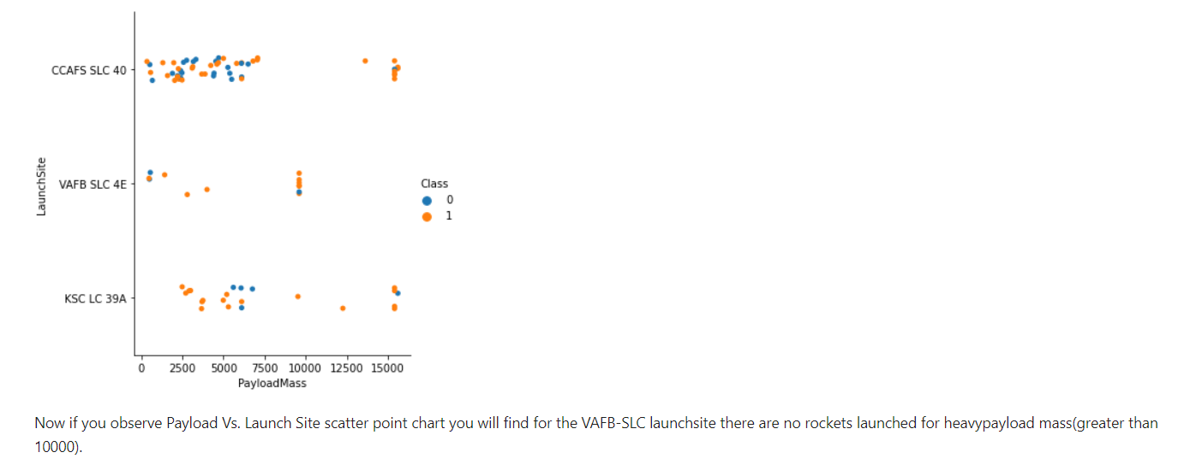
Payload vs. Launch Site

Slide 20
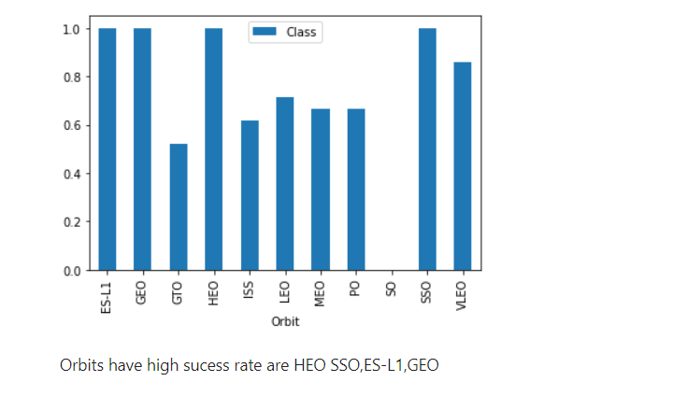
Success Rate vs. Orbit Type

Slide 21
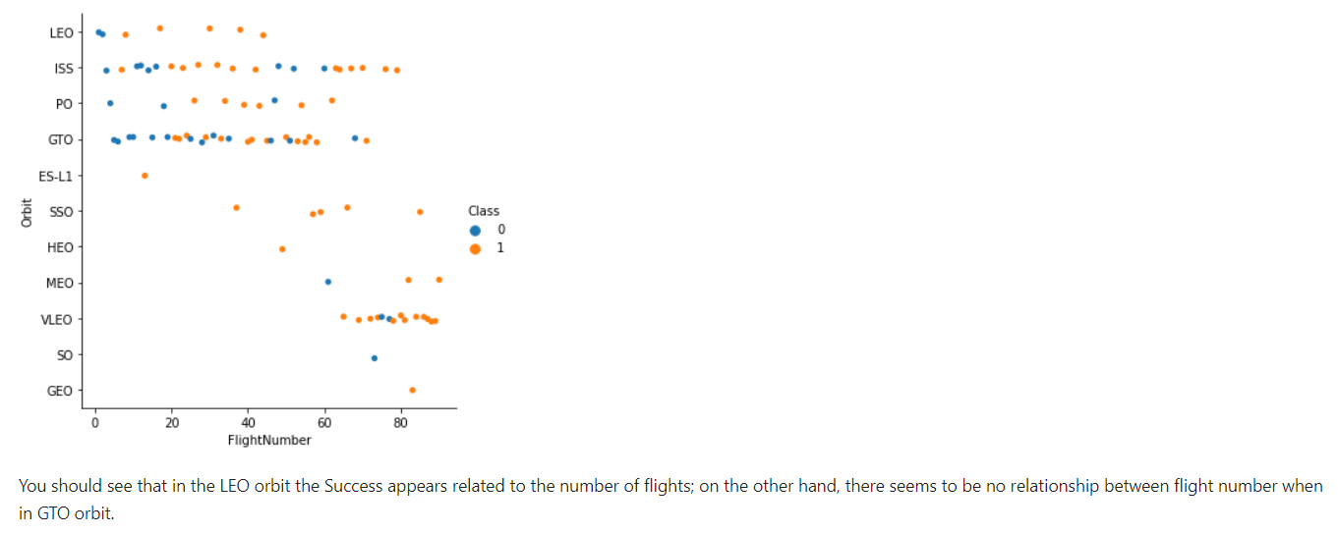
Flight Number vs. Orbit Type

Slide 22
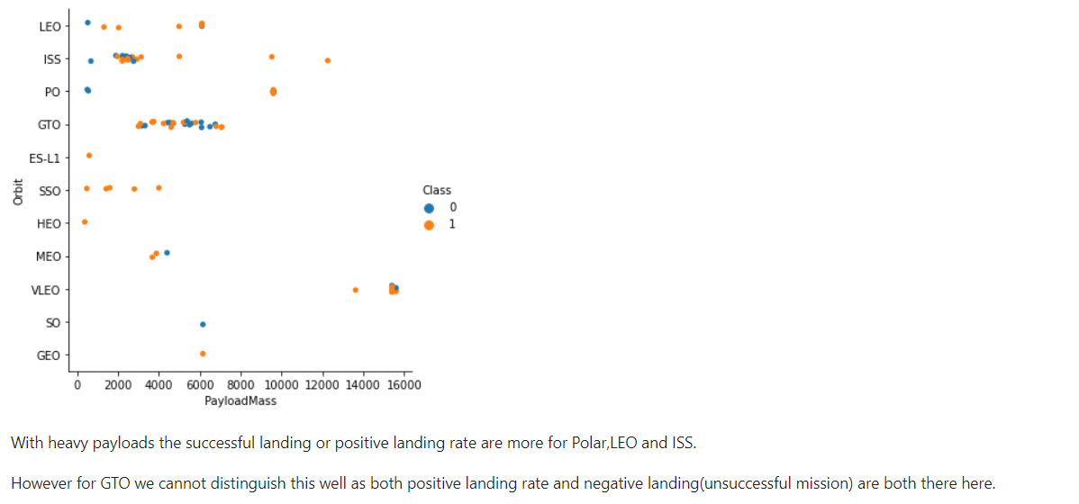
Payload vs. Orbit Type

Slide 23
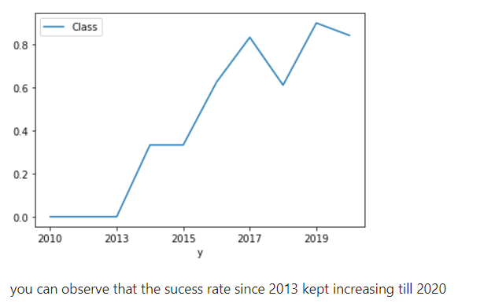
Launch Success Yearly Trend

Slide 24
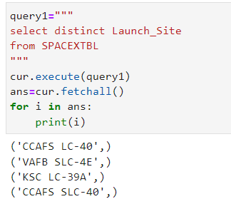
All Launch Site Names

Slide 25
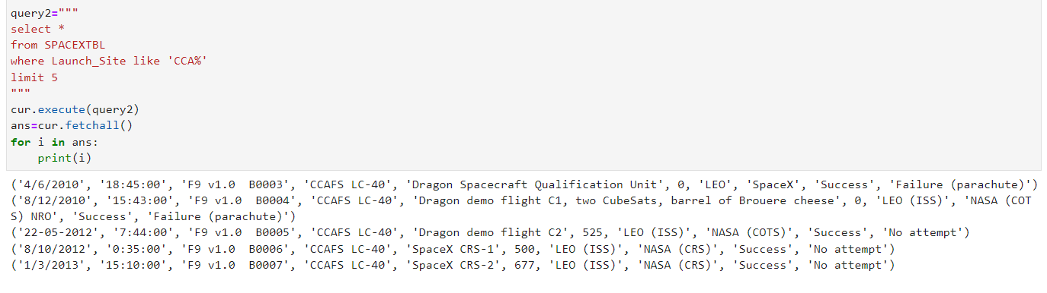
Launch Site Names Begin with 'CCA'

Slide 26
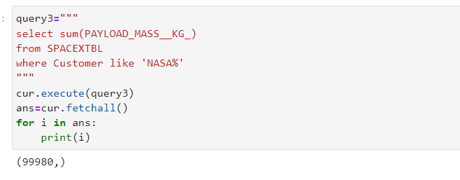
Total Payload Mass

Slide 27
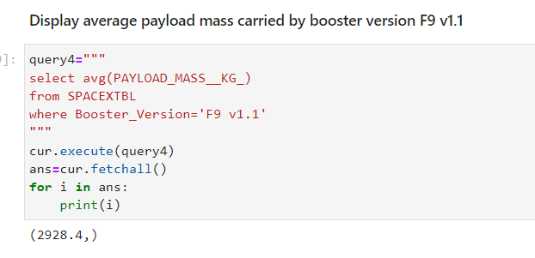
Average Payload Mass by F9 v1.1

Slide 28
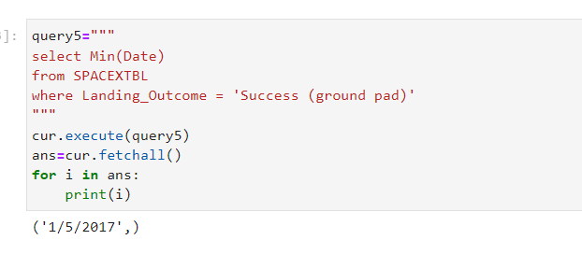
First Successful Ground Landing Date

Slide 29
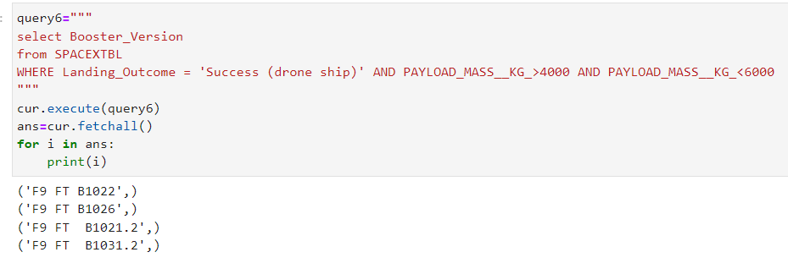
Successful Drone Ship Landing with Payload between 4000 and 6000

Slide 30
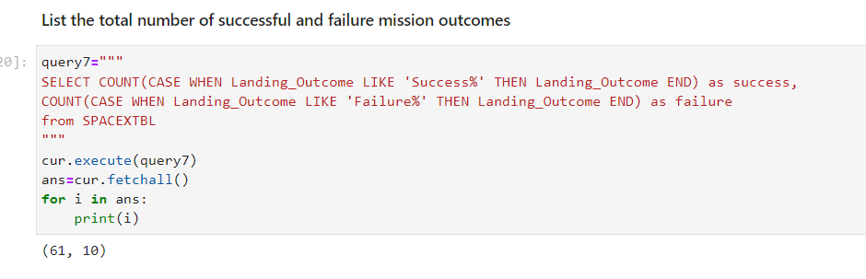
Total Number of Successful and Failure Mission Outcomes

Slide 31
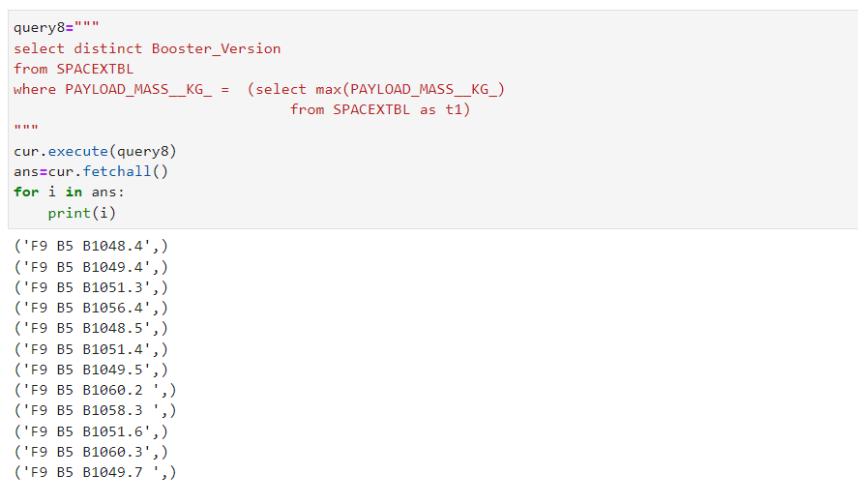
Boosters Carried Maximum Payload

Slide 32
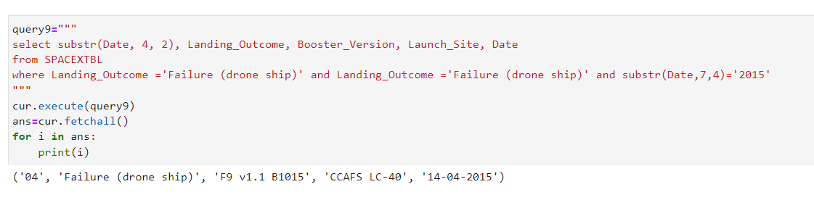
2015 Launch Records

Slide 33
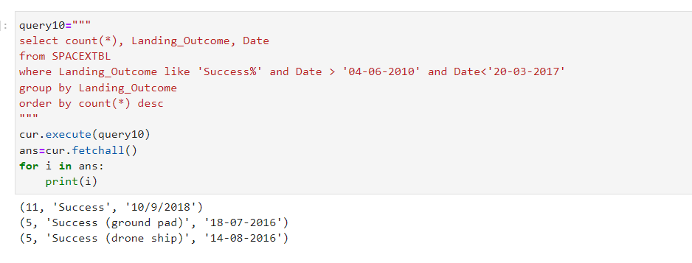
Rank Landing Outcomes Between 2010-06-04 and 2017-03-20

Slide 34

Section 3

Slide 35
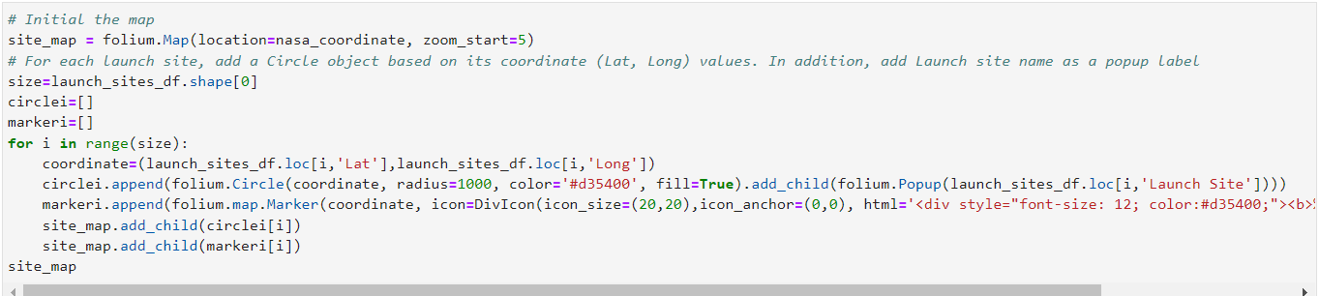
<Folium Map Screenshot 1>

Slide 36
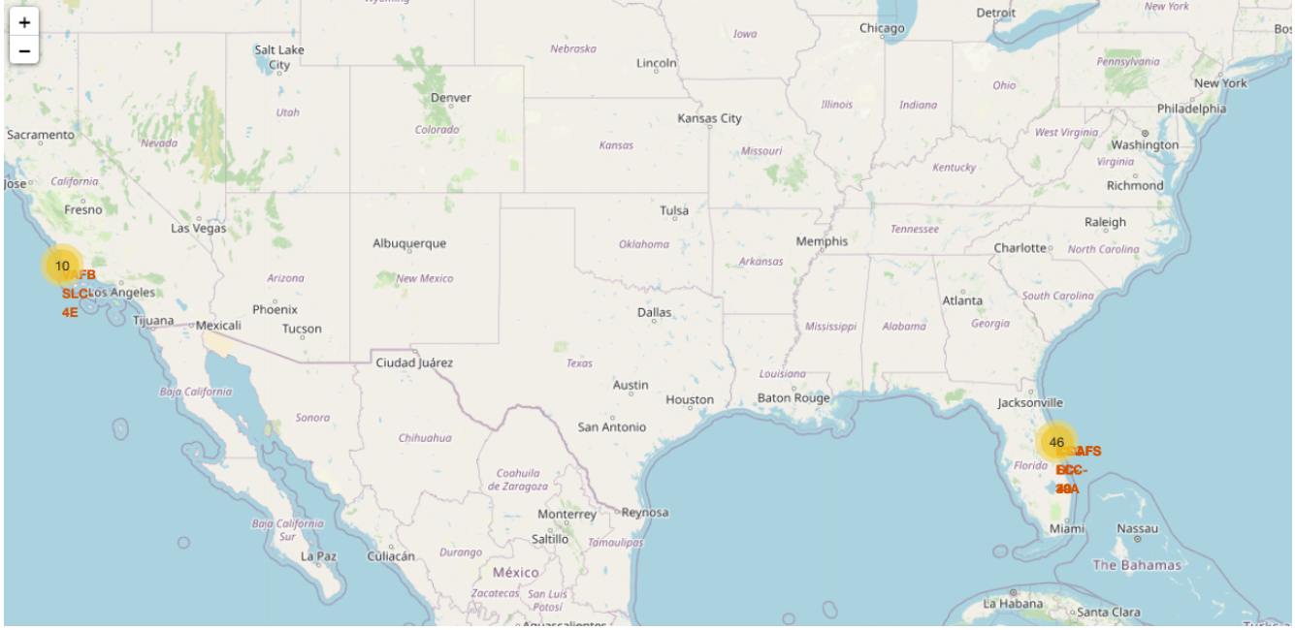
<Folium Map Screenshot 2>

Slide 37
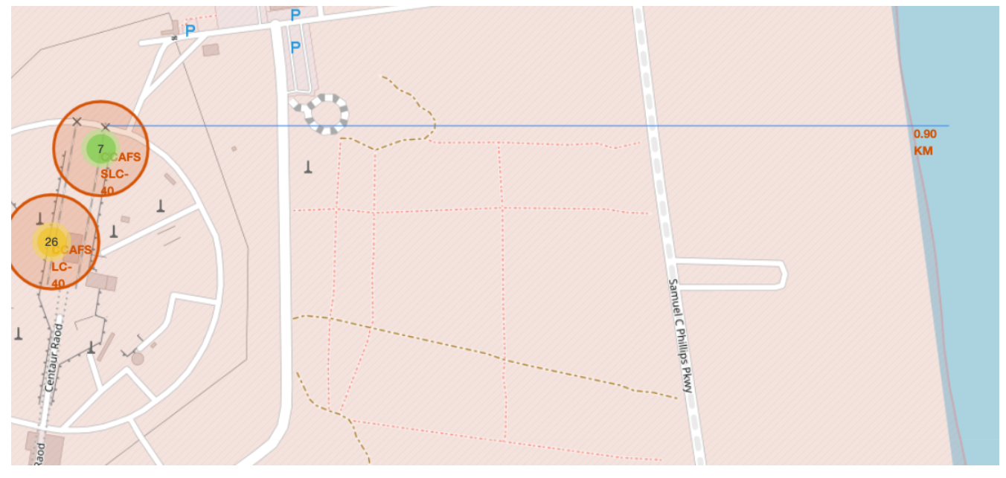
<Folium Map Screenshot 3>

Slide 38

Section 4

Slide 39
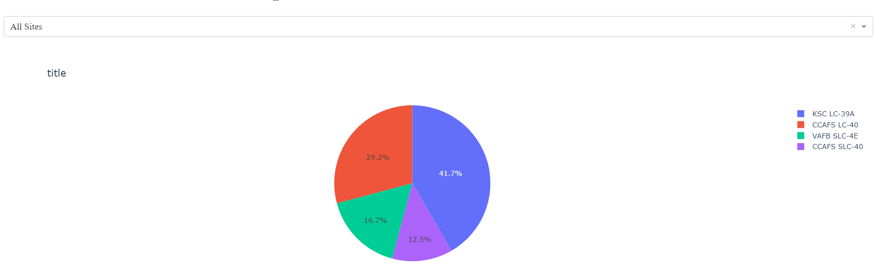
Launch success count for all sites

Slide 40
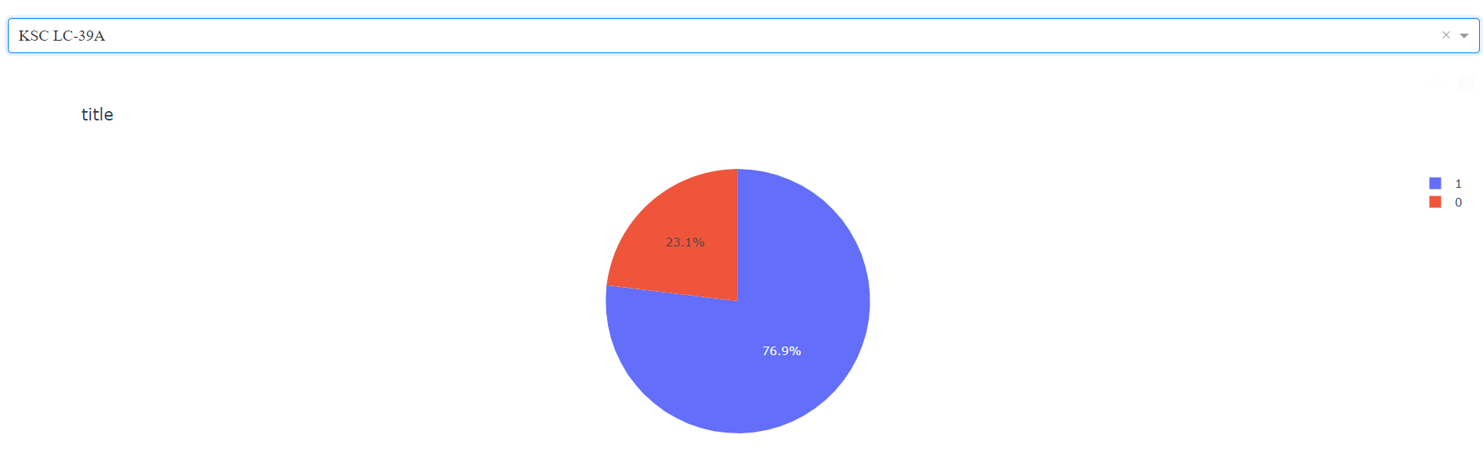
Piechart for the launch site with highest launch success ratio

Slide 41
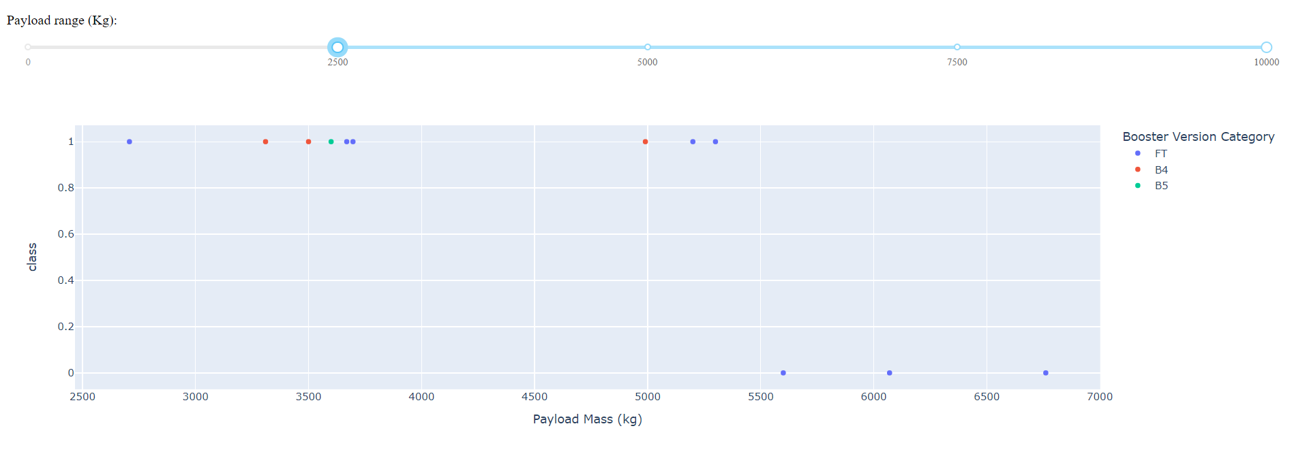
Payload vs. Launch Outcome scatter plot for all sites

Slide 42

Section 5

Slide 43
Classification Accuracy
Model has the highest classification accuracy is decision tree

Slide 44
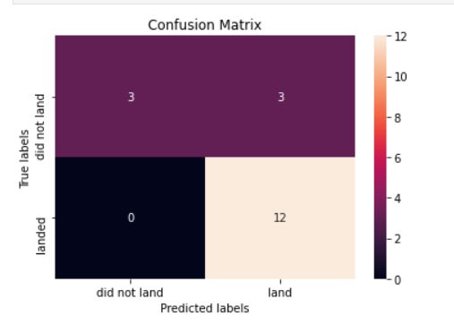
Confusion Matrix

Slide 45
Conclusions
We can use any model to predict if stage 1 land successfully with accuracy about 83%

Slide 46
Appendix
Include any relevant assets like Python code snippets, SQL queries, charts, Notebook outputs, or data sets that you may have created during this project

Slide 47


